Slide 1
Deploying SharePoint Framework components to production
Deploying to Azure Storage CDN

Slide 2
Agenda
Create Azure Storage CDN
Configure web part to deploy assets to CDN
Configure web part to use CDN
Build, deploy, install, and test
Q&A

Slide 3
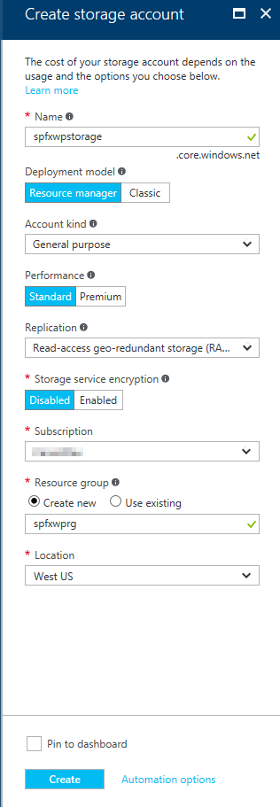
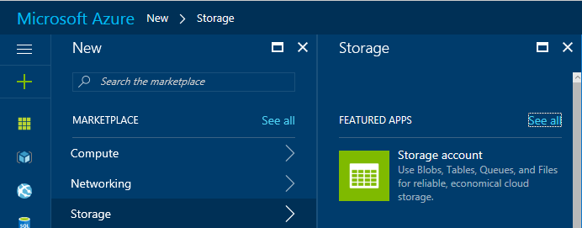
Create Azure Storage Account
Go to the Azure Management Portal
Create a new Storage Account

Slide 4
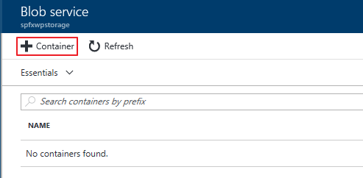
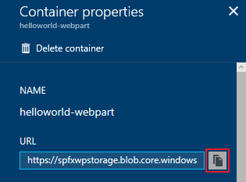
Create a Blob Container in the Storage Account
Create a Blob Container and copy the URL

Slide 5
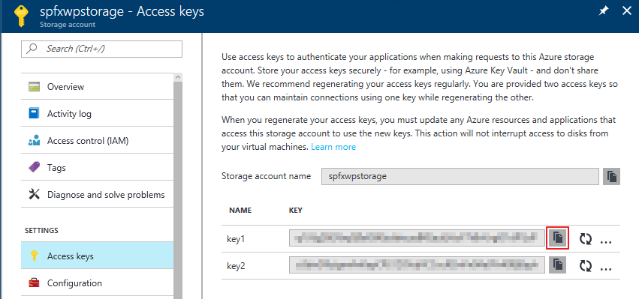
Obtain Storage Account Access Key
The Storage Account Access Key is used to automate deployments to the Azure Storage CDN, copy one of the keys

Slide 6
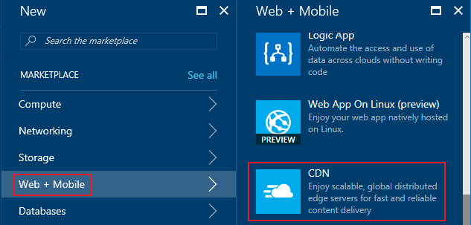
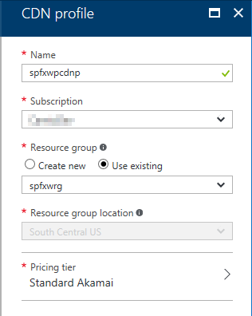
Create CDN Profile
In the Azure Management Portal, create a new CDN Profile

Slide 7
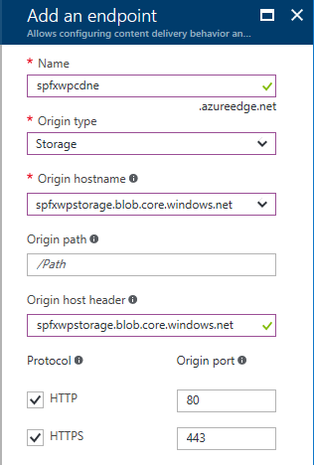
Create CDN Endpoint
In the CDN Profile, create a new CDN endpoint

Slide 8
Configure the web part to deploy assets to the CDN
Update the account, container, and accessKey in the deploy-azure-storage.json file
account – Storage account name
container – Name of the container you wish to use for the web part
accessKey – Storage Account Access Key
{
"workingDir": "./temp/deploy/",
"account": "spfxwpstorage",
"container": "helloworld-webpart",
"accessKey": "hL2503 … "
}

Slide 9
Configure the web part to use the CDN
Create CDN base path
Update the cdnBasePath in the write-manifests.json file
https://<Storage Account Name>.blob.core.windows.net/<Container Name>
{
"cdnBasePath": "https://spfxwpstorage.blob.core.windows.net/helloworld-webpart"
}

Slide 10
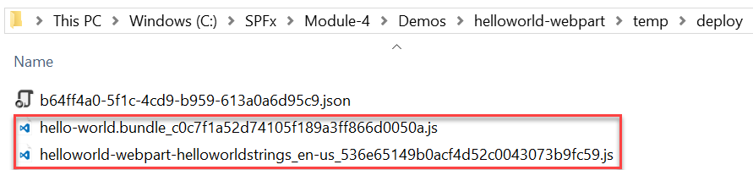
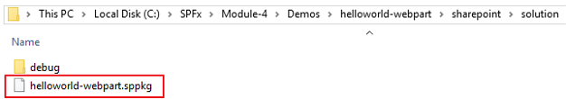
Package the web part
Use the bundle gulp task to build, localize, and bundle the project
Use the package-solution gulp task to package the project into a .sppkg file
The ship parameter build task creates a minified version of the bundle and copies all of the web part assets, including the web part bundle, into the temp\deploy folder. The .sppkg folder is generated in the sharepoint\solution folder.
> gulp bundle --ship
> gulp package-solution --ship

Slide 11
Deploy web part assets to the Azure Storage Account
Use the deploy-azure-storage gulp task to deploy the assets to the Azure Storage Account
> gulp deploy-azure-storage
> gulp deploy-azure-storage
Build target: DEBUG
[11:56:24] Using gulpfile C:\SPFx\helloworld-webpart\gulpfile.js
[11:56:24] Starting gulp
[11:56:24] Starting 'deploy-azure-storage'...
[11:56:24] Starting subtask 'deploy-azure-storage'...
[11:56:24] [deploy-azure-storage] Uploading files '**/*.*' from directory './temp/deploy/' to Azure
[11:56:25] [deploy-azure-storage] Created container: helloworld-webpart
[11:56:25] [deploy-azure-storage] Uploading [3] files...
[11:56:26] [deploy-azure-storage] Uploaded file: helloworld-webpart-helloworldstrings_en-us_536e65149b0acf4d52c0043073b9fc59.js
[11:56:26] [deploy-azure-storage] Uploaded file: hello-world.bundle_b8a80975dedeb31de300b580fab61182.js
[11:56:26] [deploy-azure-storage] Uploaded file: dd331d09-a9cd-448d-a687-7e43060191e2.json
[11:56:26] [deploy-azure-storage] Upload complete!
[11:56:26] [deploy-azure-storage] Access your files at: https://spfxwpstorage.blob.core.windows.net/helloworld-webpart
[11:56:26] Finished subtask 'deploy-azure-storage' after 1.92 s
[11:56:26] Finished 'deploy-azure-storage' after 1.93 s
[11:56:26] ==================[ Finished ]==================
[11:56:27] Project helloworld-webpart version: 0.0.1
[11:56:27] Build tools version: 2.4.0
[11:56:27] Node version: v6.10.0
[11:56:27] Total duration: 5.94 s
deploy-azure-storage

Slide 12
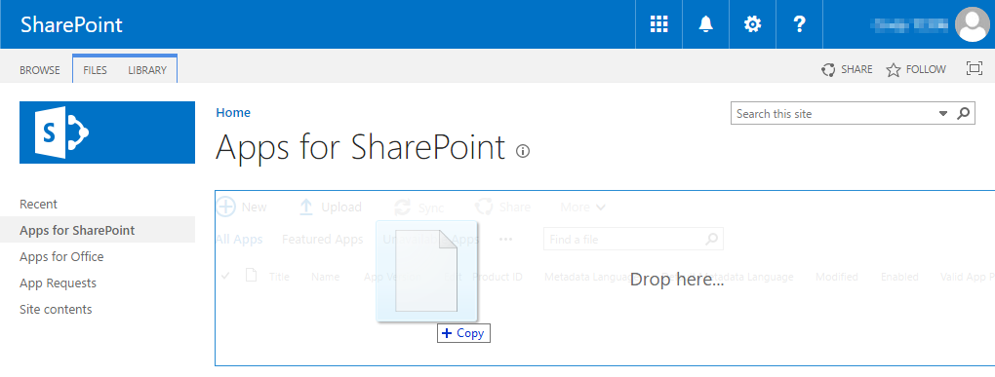
Deploy App to the SharePoint App Catalog
Go to your Office 365 App Catalog site
In the left sidebar, choose Apps for SharePoint
Upload the package (.sppkg file) for the web part

Slide 13
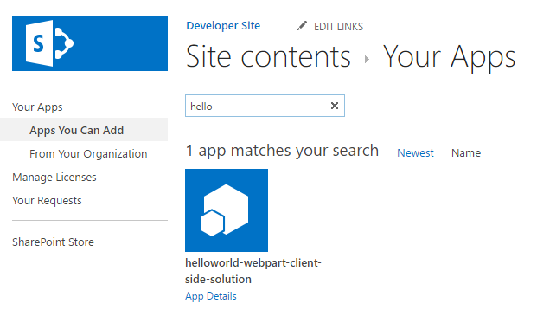
Install the App
Go to your Office 365 site
Add the App you just deployed to the SharePoint App Catalog

Slide 14
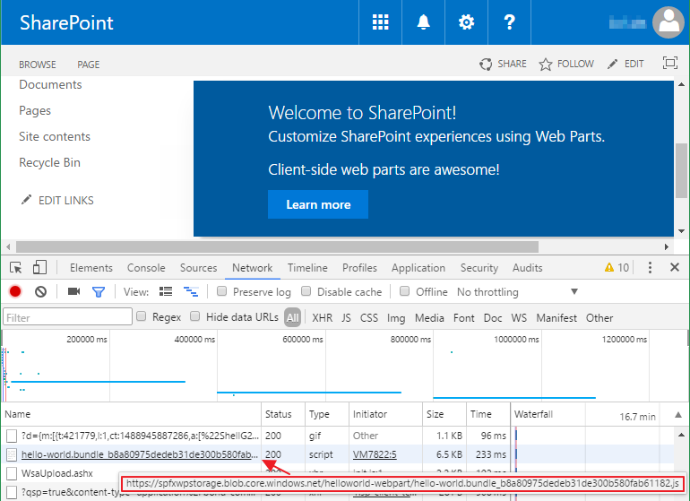
Add the web part to a SharePoint page
After the web part assets are deployed to a CDN location you can preview the web part
Create a page on your Office 365 site and add the web part to the page
In the developer console verify the assets are served from the CDN

Slide 15
DEMO
Deploy web part resources to an Azure Storage CDN
Notes:
Use Exercise 3: Deploy the web part resources to an Azure Storage CDN in the lab manual.

Slide 16
Summary
Create Azure Storage CDN
Configure web part to deploy assets to CDN
Configure web part to use CDN
Build, deploy, install, and test
Q&A

Slide 17
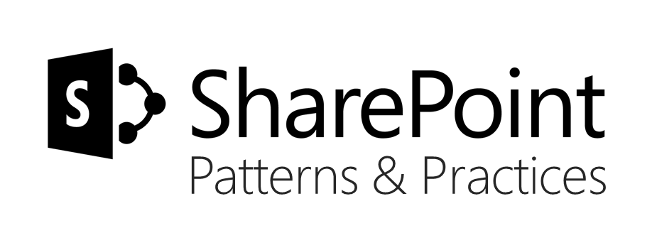
Sharing is caring…
Code samples and solutions
Reusable components
Guidance documentation
Monthly community calls
SharePoint Framework
SharePoint add-ins
Microsoft Graph
Office 365 APIs
http://aka.ms/SharePointPnP

Slide 18

Q&A

Slide 19


